Slide 1
Software Project Management – Caselet 1- SDLC methodology choice.
S Subramanian ( Subbu)

Slide 2
Caselet – Scenario
Customer is demanding a particular SDLC execution methodology – AGILE
Your company’s experience in AGILE is limited
You (PM) are not sure of client’s maturity in AGILE process
Your Sales team has already sold AGILE expertise to the client (so you can’t back out)
Either you follow AGILE or you don’t lead the project – choice is yours.

Slide 3
Cost of Change
Agile- governance
The word “steering” implies active management involvement and frequent course-correction to produce better results. All stakeholders must collaborate to converge on moving targets, and the principles above delineate the economic foundations necessary to achieve good steering mechanisms
The cost of change in a real-world enterprise system is never that small. You must plan for change, and understand its costs.

Slide 4
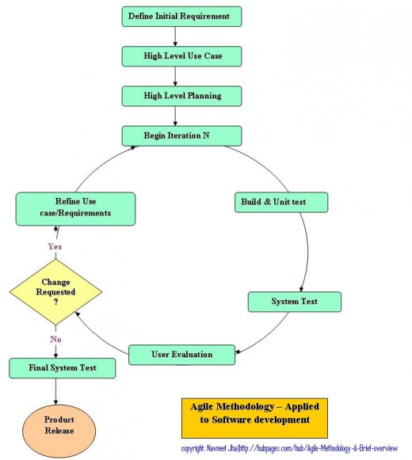
AGILE Process

Slide 5
Strong Architecture
You must deliver an architecture which can accommodate likely change in the best way for the enterprise
It reduces the cost of change,
It provides a reference against which the sillier requirements can be challenged,
It can provide mechanisms which allow incorrect requirements to be rapidly reversed out

Slide 6
AGILE – Project management
Client must embrace Agile process
Continuous and serious involvement from client.
Daily stand up meeting
Empowered development teams
Strong PM is mandated
Estimation & Costing
Prefer T&M contracts over Fixed Price
Strong Change Control Board

Slide 7
Summary
For Agile process to succeed:
Get high level business requirements in as much detail as possible
Track Changes rigorously
Build strong Architecture upfront ( CBD)
Make sure at least 70% of your team size is experienced
Use good estimation process ( UCP/ Story Board)
Prefer T&M contract
It is a two way street, make sure client is actively involved throughout SDLC.
Follow SCRUM process.

Slide 8


